Slide 1
Unconditional Correlation and Conditional Correlation in Commodity Futures and Equity Markets
Alexander Collins, Ruoning Guan, and Fan Lu

Slide 2
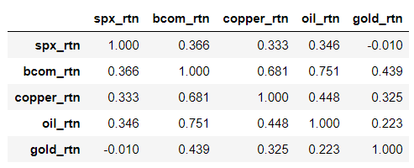
Daily correlation coefficient from 2008 to 2019

Slide 3
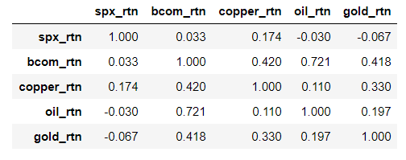
Daily correlation coefficient from 2000 to 2007

Slide 4
Dynamic Correlation Coefficient (DCC-GARCH)
First, find GARCH model in each assets.
Than, use GARCH model to find DCC-GARCH model
GARCH model is an expansion of the ARCH model, and the ARCH model has five properties. As an example, we use SPX Index to prove these properties.

Slide 5
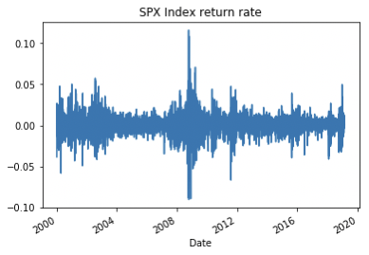
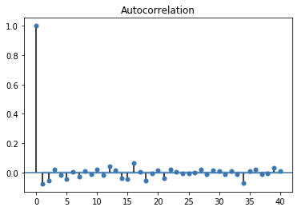
Property 1: No Autocorrelation in Returns
The autocorrelation in the levels of returns demonstrated in following figure shows that
predicting the direction of asset returns is not possible.

Slide 6
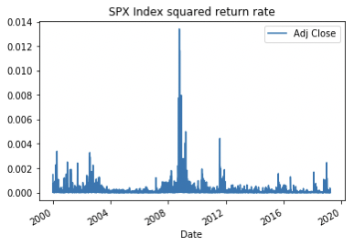
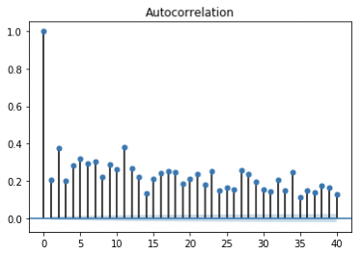
Property 2: Autocorrelation in Squared Returns
The autocorrelation in the squares of returns demonstrated in following figure shows that
while predicting the direction of returns is not possible, predicting their volatility is.

Slide 7
Property 3: Volatility Clustering
The volatility clustering property shows that small movements in returns tend to be
followed by small returns in the next period, whereas large movements in returns tend to be followed by large returns in the next period.

Slide 8
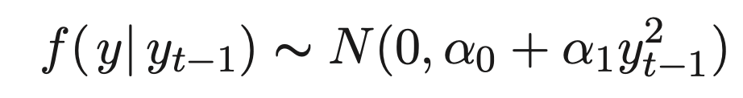
Property 4: Conditional Normality
The conditional distribution of returns is normal with conditional mean and conditional variance given by :
Therefore, a high probability of drawing another large value of y in the next period.

Slide 9
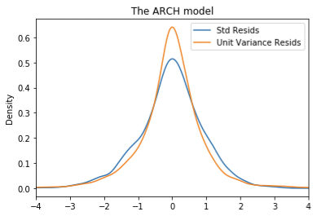
Property 5: Unconditional Leptokurtosis
f(y), that has fat tails­ and a sharp peak compared to the normal distribution.

Slide 10
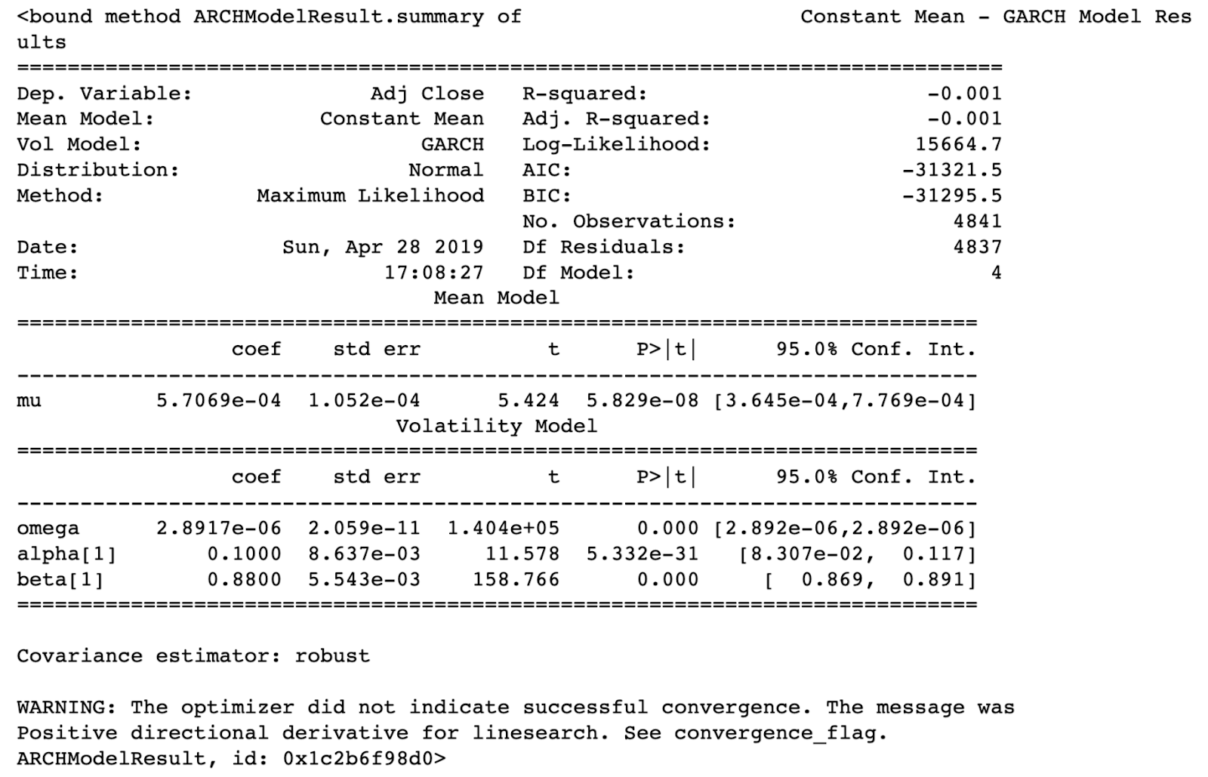
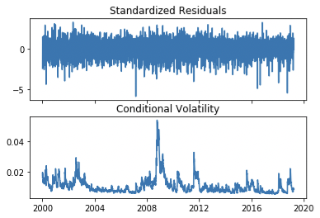
SPX Index GARCH model

Slide 11
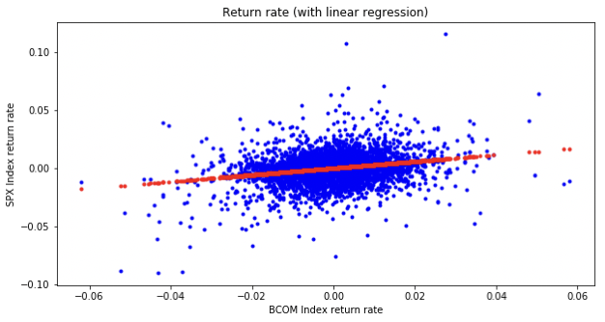
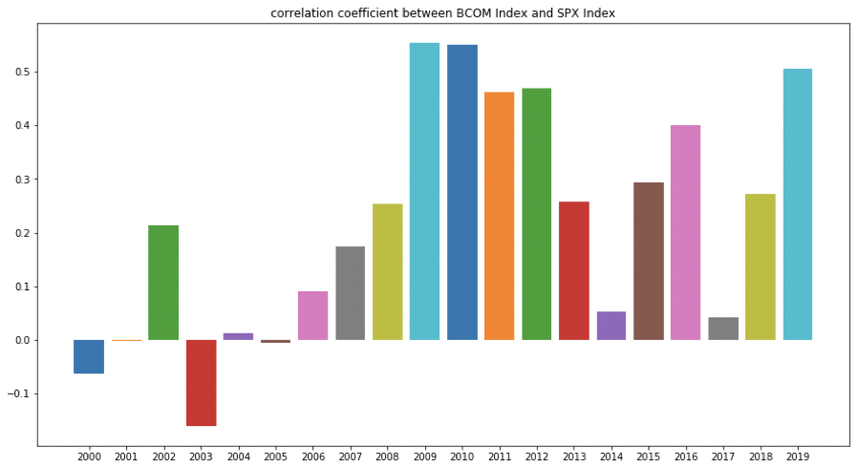
Compare other ways to find correlation
Linear regression
Yearly correlation coefficient bar graph

Slide 12
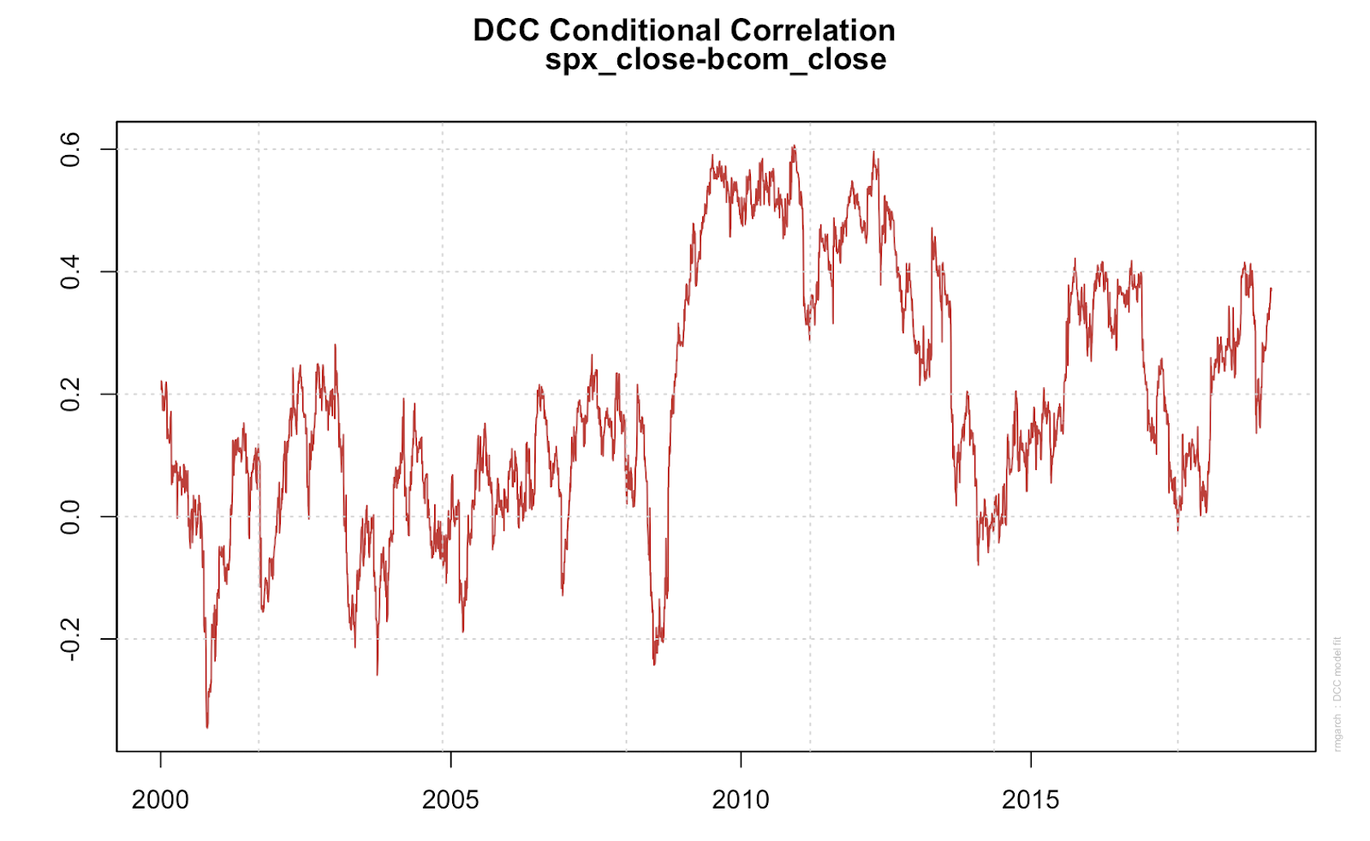
DCC Conditional Correlation
*---------------------------------*
* DCC GARCH Fit *
*---------------------------------*
Distribution : mvnorm
Model : DCC(1,1)
No. Parameters : 11
[VAR GARCH DCC UncQ] : [0+8+2+1]
No. Series : 2
No. Obs. : 4801
Log-Likelihood : 31327.21
Av.Log-Likelihood : 6.53
Optimal Parameters
-----------------------------------
Estimate Std. Error t value Pr(>|t|)
[bcom_close].mu -0.000035 0.000124 -0.28333 0.776921
[bcom_close].omega 0.000000 0.000000 2.04510 0.040845
[bcom_close].alpha1 0.038938 0.002273 17.12749 0.000000
[bcom_close].beta1 0.956507 0.001613 592.84045 0.000000
[spx_close].mu 0.000552 0.000116 4.73750 0.000002
[spx_close].omega 0.000002 0.000001 1.60162 0.109240
[spx_close].alpha1 0.107606 0.016534 6.50798 0.000000
[spx_close].beta1 0.877259 0.017101 51.29839 0.000000
[Joint]dcca1 0.018662 0.003943 4.73276 0.000002
[Joint]dccb1 0.978193 0.005044 193.94392 0.000000
Information Criteria
---------------------
Akaike -13.046
Bayes -13.031
Shibata -13.046
Hannan-Quinn -13.040
Elapsed time : 2.836058

Slide 13
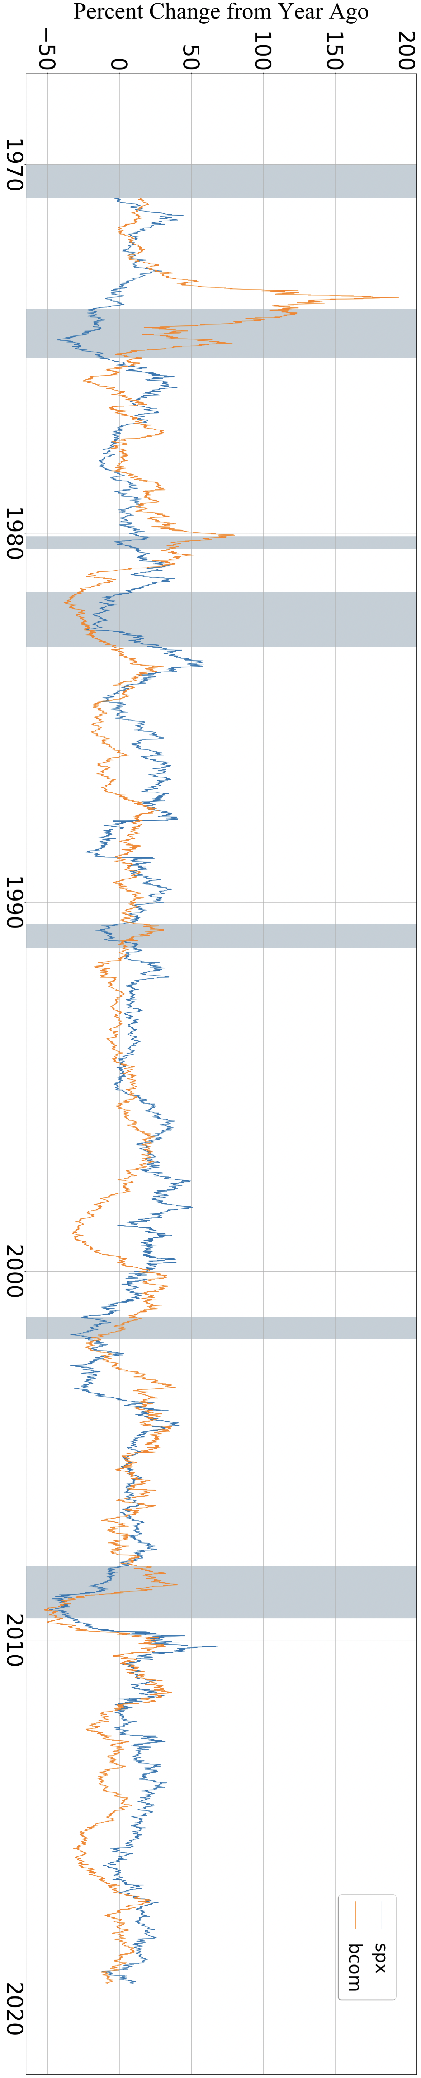
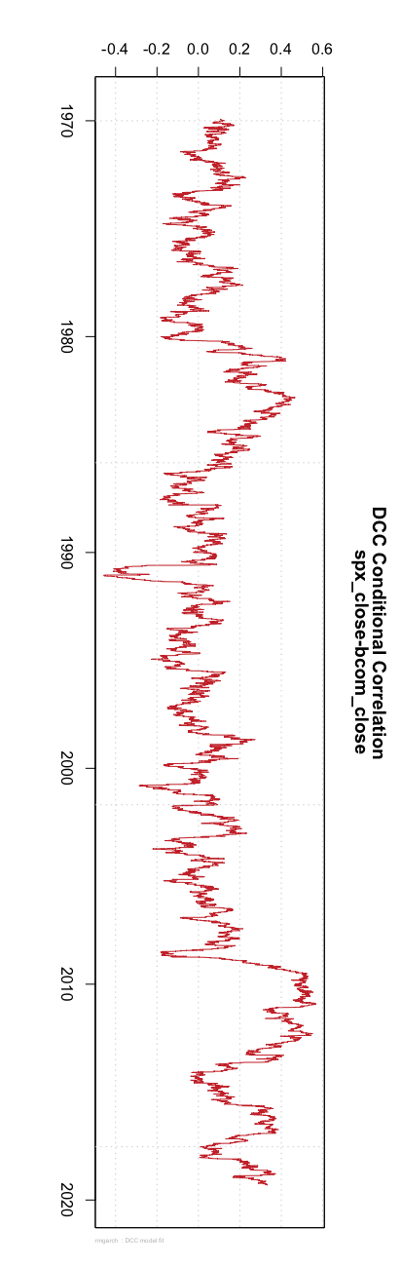
DCC conditional correlation graph and business cycle graph (from year 1970 until year 2019 )

